Slide 1
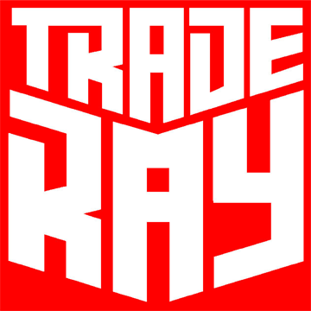
WELCOME TO TRADE RAY

Slide 2
INTRODUCTION:
Trade Ray is a company formed up for trading with the motto, “Trade for Future “. It has been working since 2014 with good reputation. It was also kept in key consideration to be a part of the economic and technological development of Bangladesh. Trade Ray is now focusing into bringing out the new technological inventions as well as developments in textile sectors, which involves lot of efforts on marketing and training. Thus trade ray operates with a bunch of full time experienced technologist and business graduates. These technologists are busy always in learning new developments and inventions. They are also getting training from the principle companies in order to share the know how after wards. Also this technical team is providing a very good after sales service to the clients. The business graduates are busy in market analysis, segmentation and sales. They are often visiting the clients for promoting new products, taking their needs, feedback, etc. Thus Trade Ray forms good market coverage.

Slide 3
OUR PRESENT PRINCIPAL
COMPANIES

Slide 4
ANTEX MACHINE

Slide 5
Antex Intro:
Antex is a Italy based company that specializes in multicolor space dying machine. Years of experience allow ANTEX to build quality machines for dyeing multicolour with space dyeing system.Continuous innovation is based on the work done by continuous and steady cooperation with customers from all over the world.
Multicolor dyeing machinery manufacturing concern:
Conoprint: effects of multicolor yarn in cones
Magic Box : the new frontier of printes hanks
Rotoprint: multicolor effects working continuously on the yarn - output on hanks.
Multispace: multicolor effects on hanks, finished garments, fabrics
Magic Rain: effects multicolor melange working continuously on the yarn - output on hanks

Slide 6
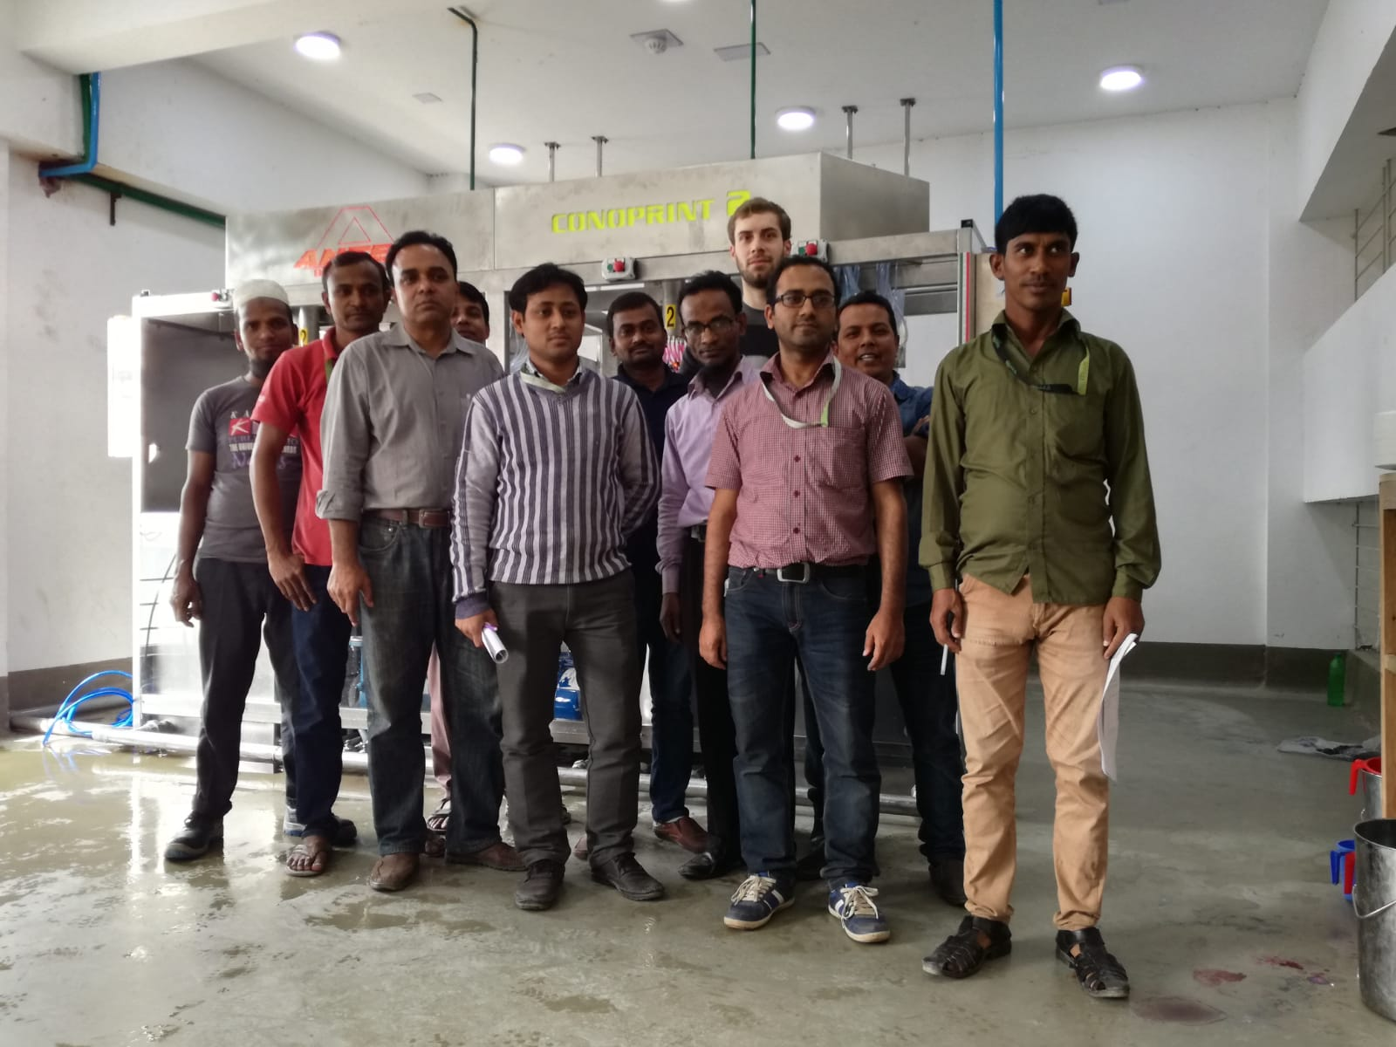

Slide 7
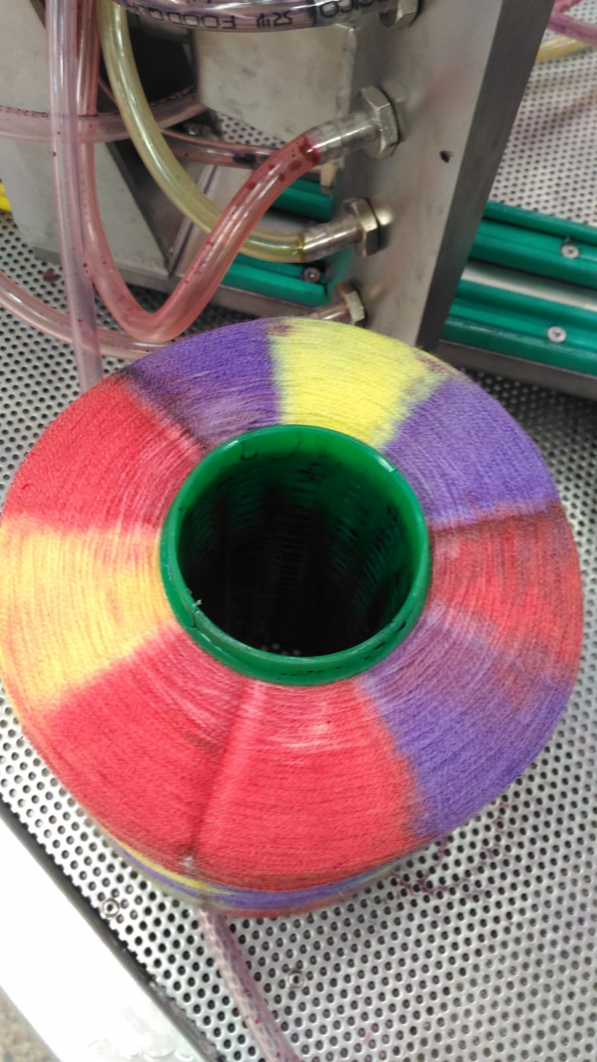
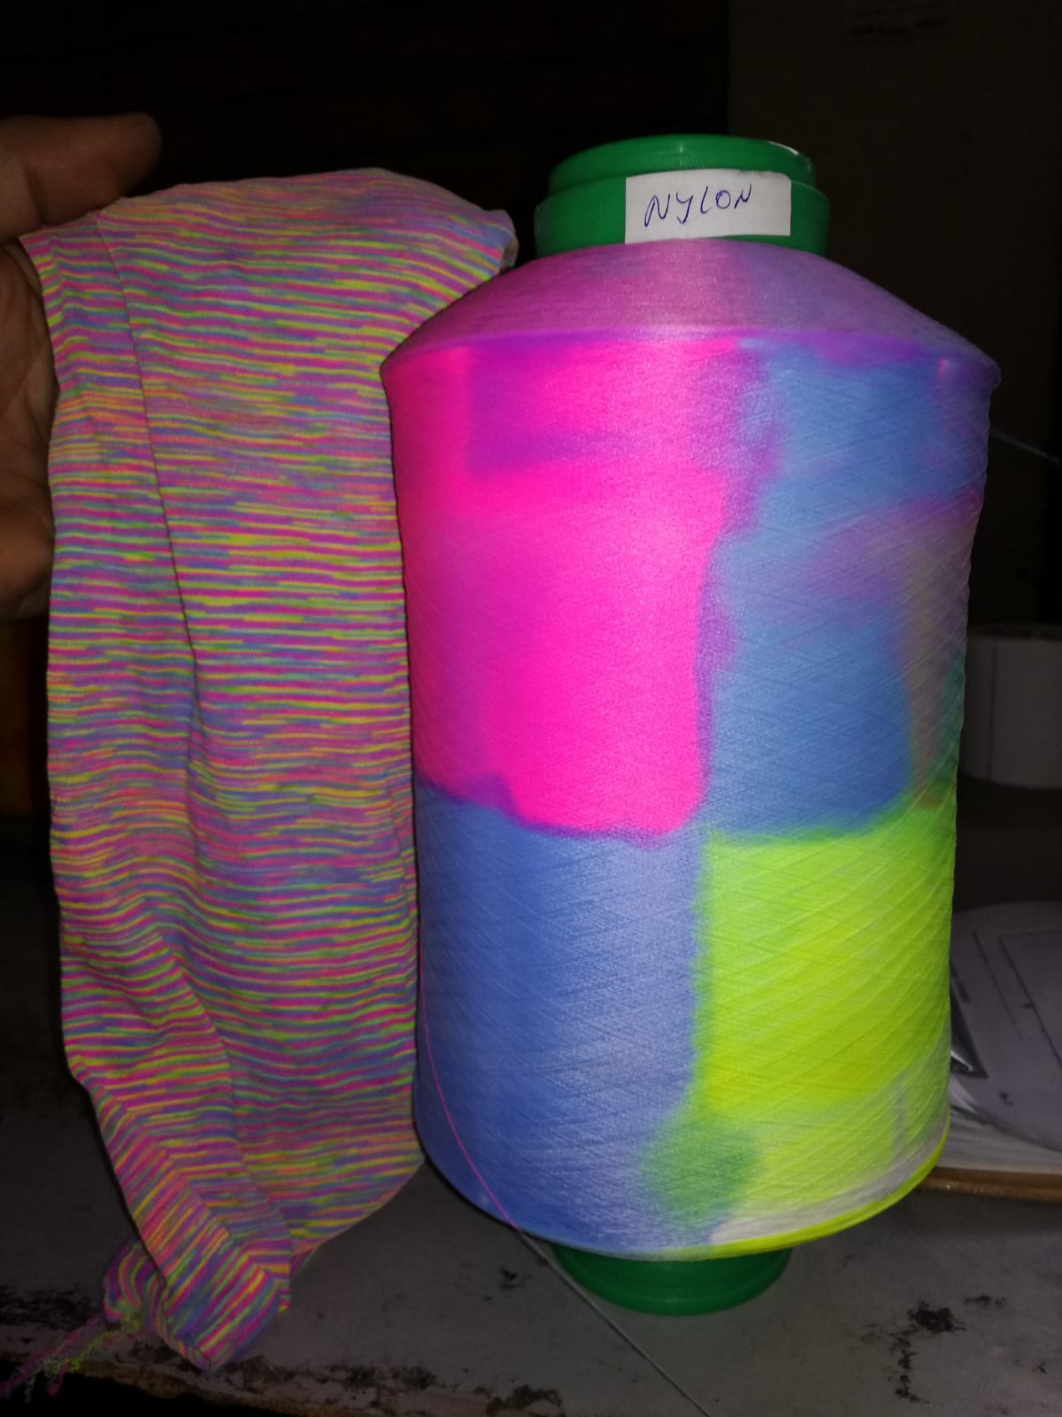
Antex thread cone

Slide 8
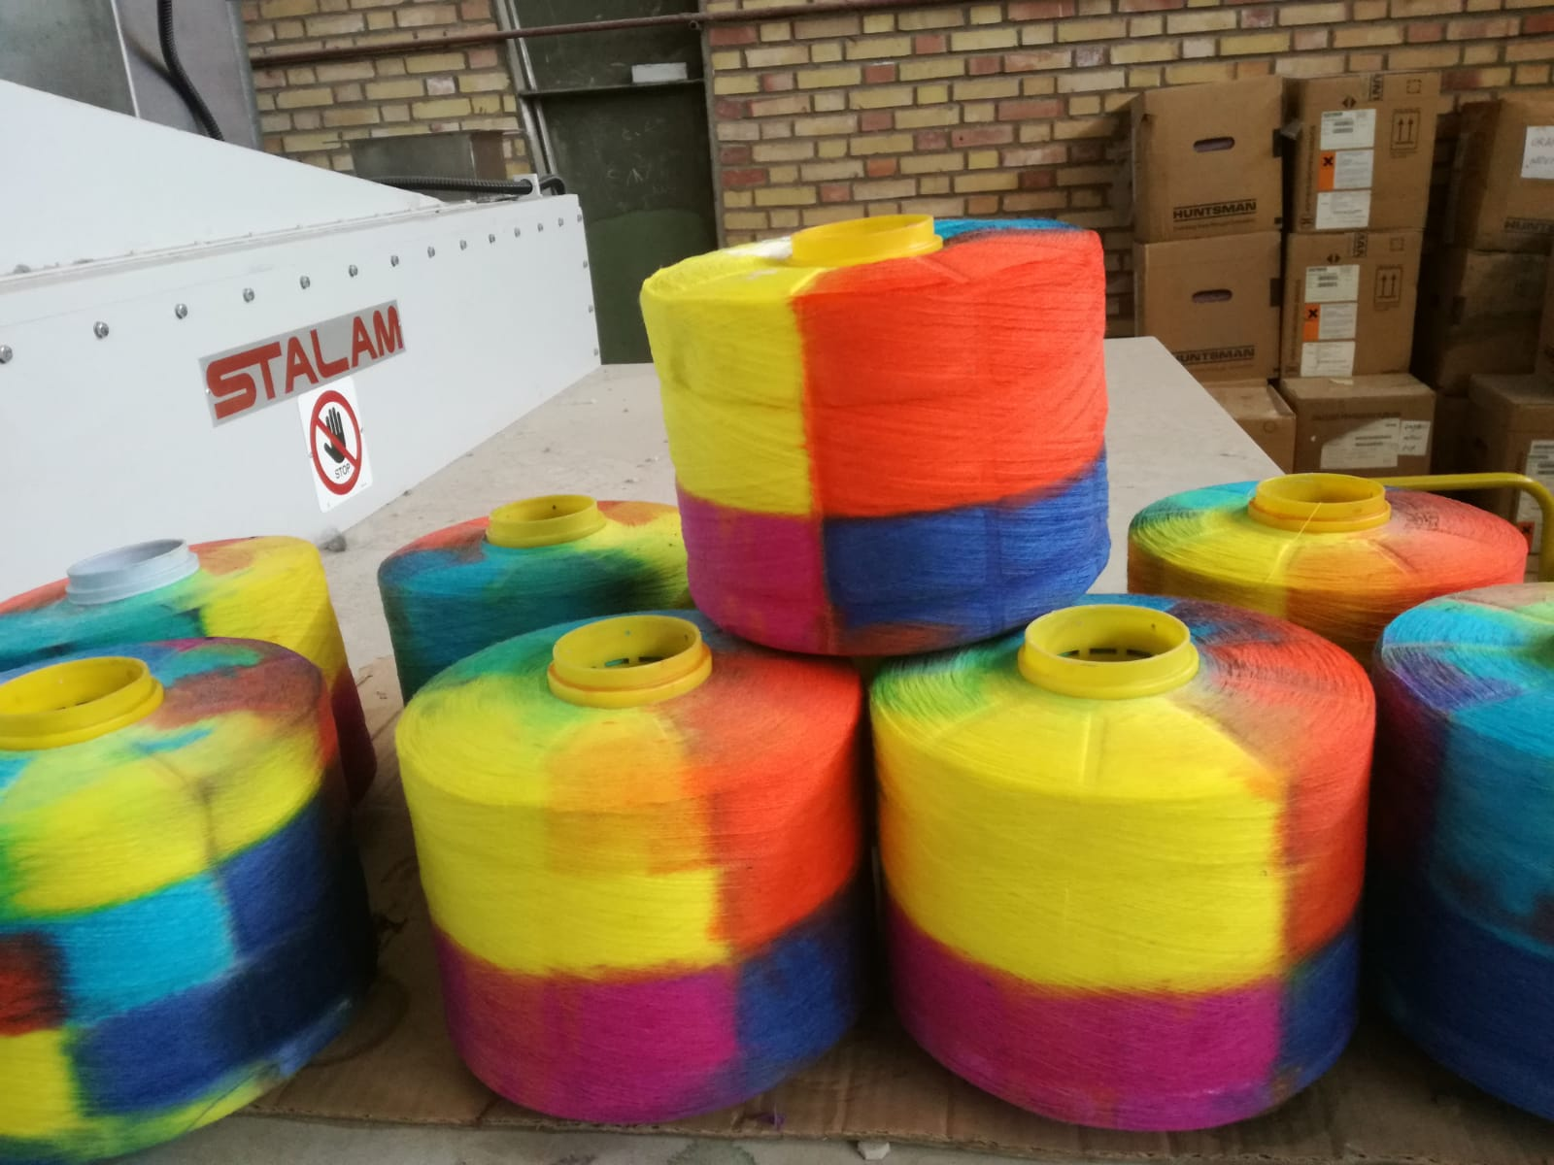

Slide 10
Erbatech GmbH, based in Erbach, Germany, develops, designs and manufactures high end solutions for wet finishing of knitted and woven fabrics. After 50 years in the business, Erbatech GmbH has become the market leader in solutions specially designed for knit dyers and finishers.
Our objective is to provide the textile industry with well proven machines for bleaching, CPB dyeing, washing and impregnation of delicate textiles, giving our customers great results and productivity with the lowest electric, water, steam and chemical consumption.

Slide 12
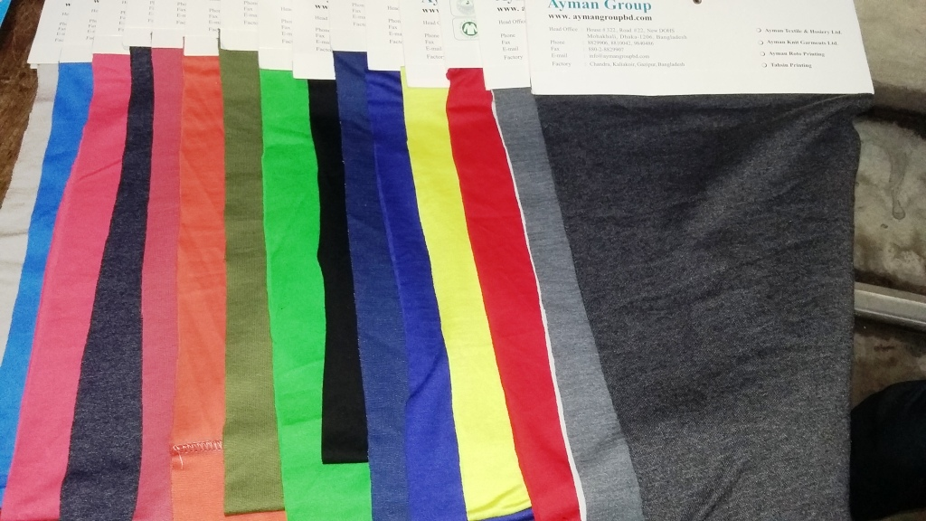
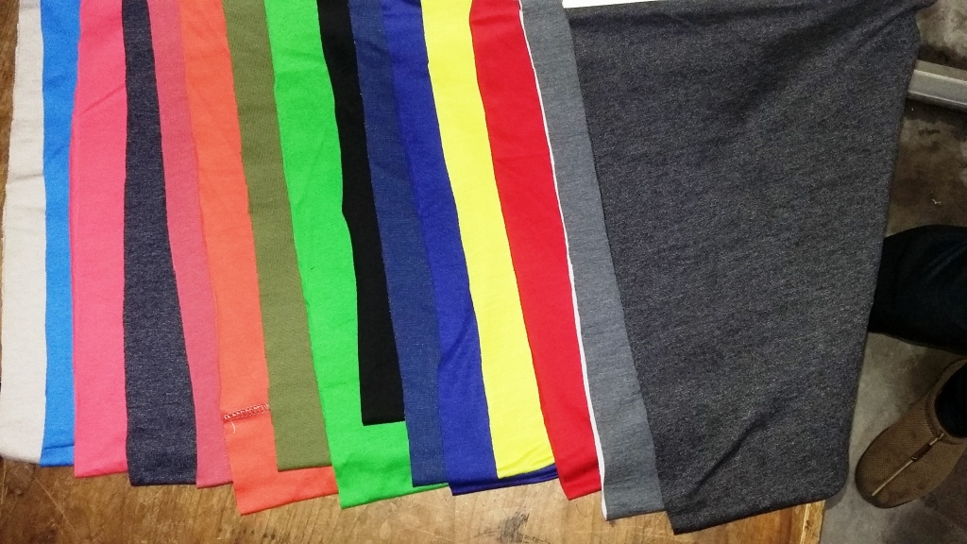

Slide 13
DONGBAO
WuXi DongBao Machinery Manufacture Co.,Ltd. is a Taiwanese joint venture which is located in the Qianzhou Industrial area. The company is specialized in designing, developing and manufacturing different series of dyeing machines. The company is able to provide outstanding assistance and excellent after-sale service, for an optimal and reliable choice of machine to fulfill the requirements for clients all around the world.

Slide 14
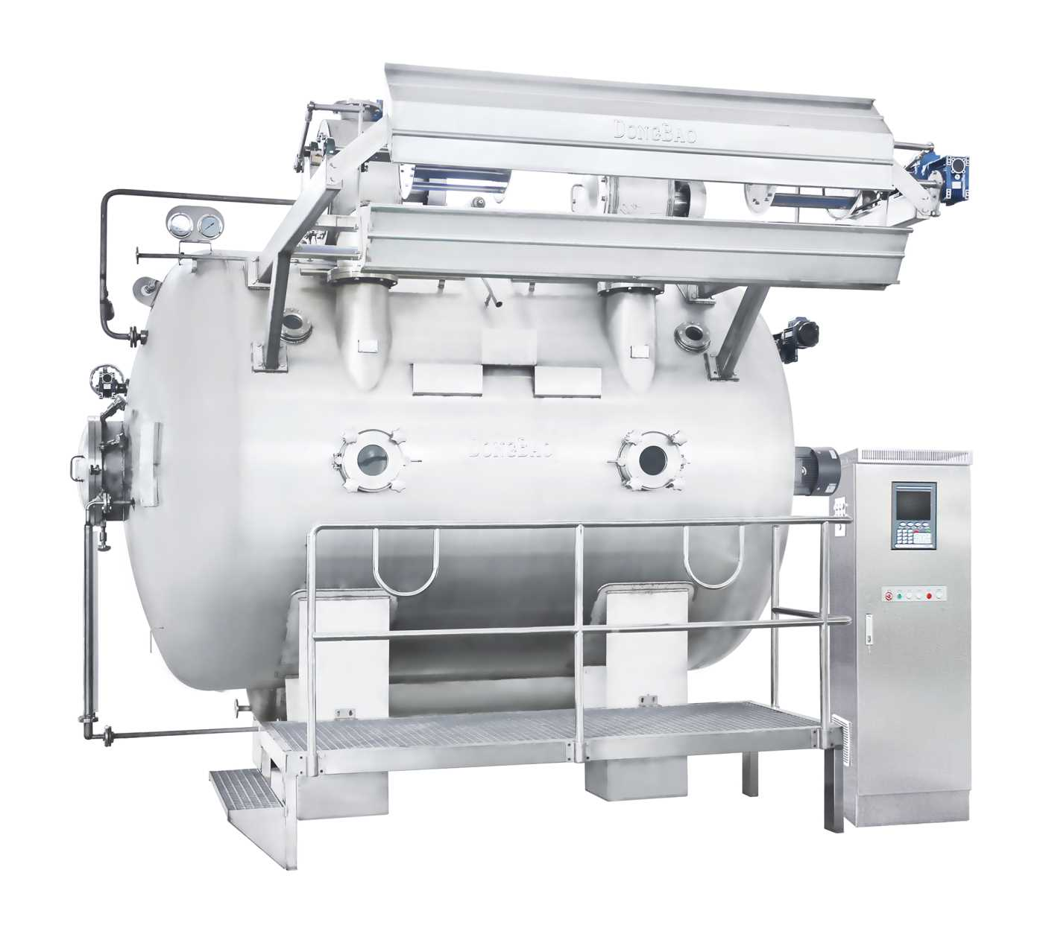

Slide 15
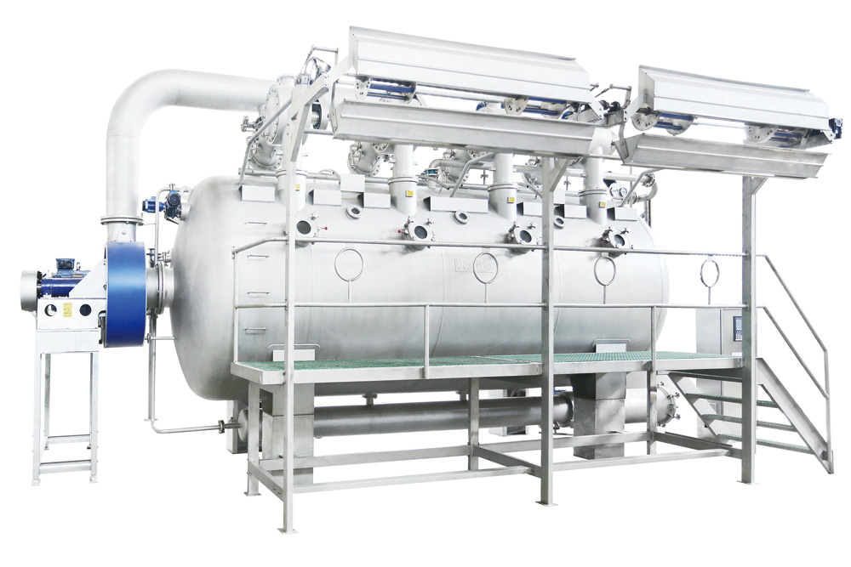

Slide 16
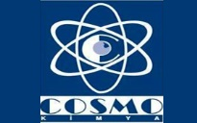
Cosmo Chemical:
Cosmo chemical is the turkey based chemical company. Cosmo Chemical has a reliable brand and solution partner for many well known local and foreign companies.

Slide 17
Our Previous Principle Companies
BENNIGER AG
The Swiss company Benninger has been the textile industry's leading partner across the globe for more than one hundred and fifty years with global branches and service representatives. Benninger develops and manufactures textile finishing and cord production ranges as well as providing complete system solutions. The vast knowledge of Benninger in the field of controls and automation is based on many years of experience with machines and ranges, also in other industries.

Slide 18
Erhardt+Leimer Inc.
Is a South Carolina based company that specializes in providing system solutions and process control equipment to web based industries. Our complete range of web guiding, web tension control and vision systems provide the technology and the flexibility to serve all requirements for standard and custom applications. With almost 40 years of experience in providing process control solutions to the textile, converting, printing, corrugating, non-woven, tire & rubber, paper manufacturing, plastics, packaging, and carpet industries, Erhardt + Leimer Inc. has become the recognized leader.

Slide 19
Meeting of World Bank

Slide 20
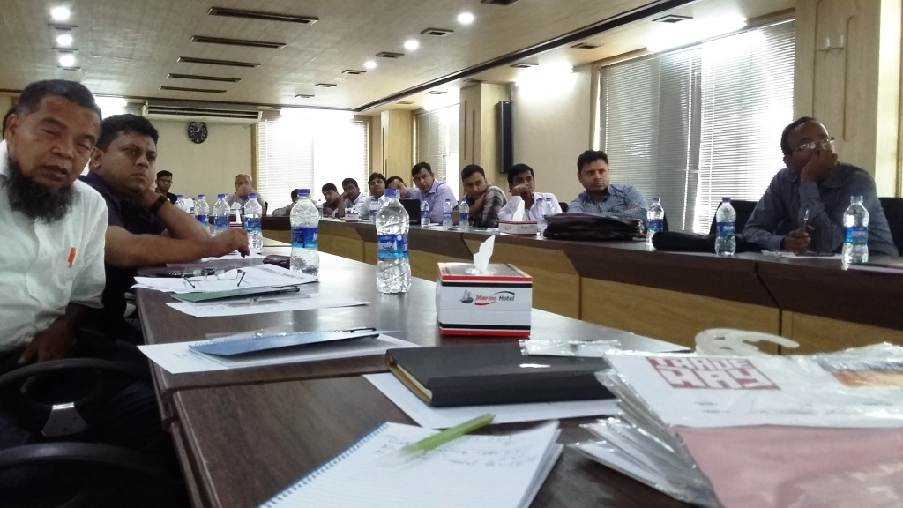

Slide 21
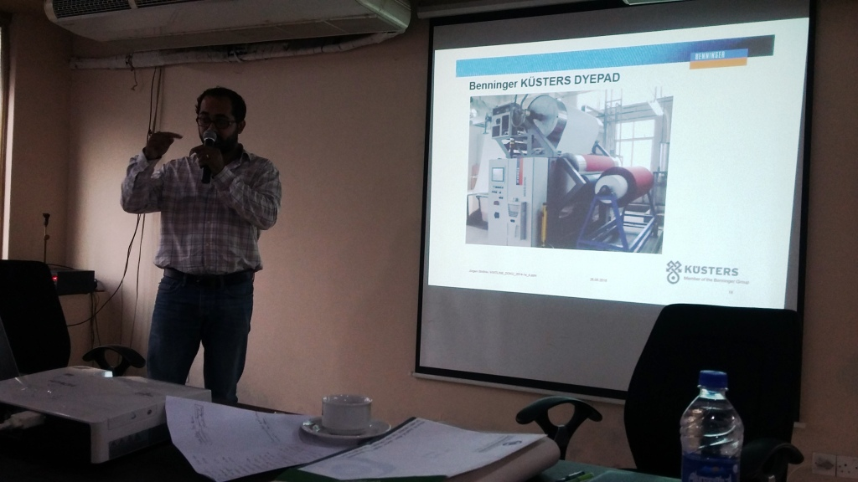

Slide 22
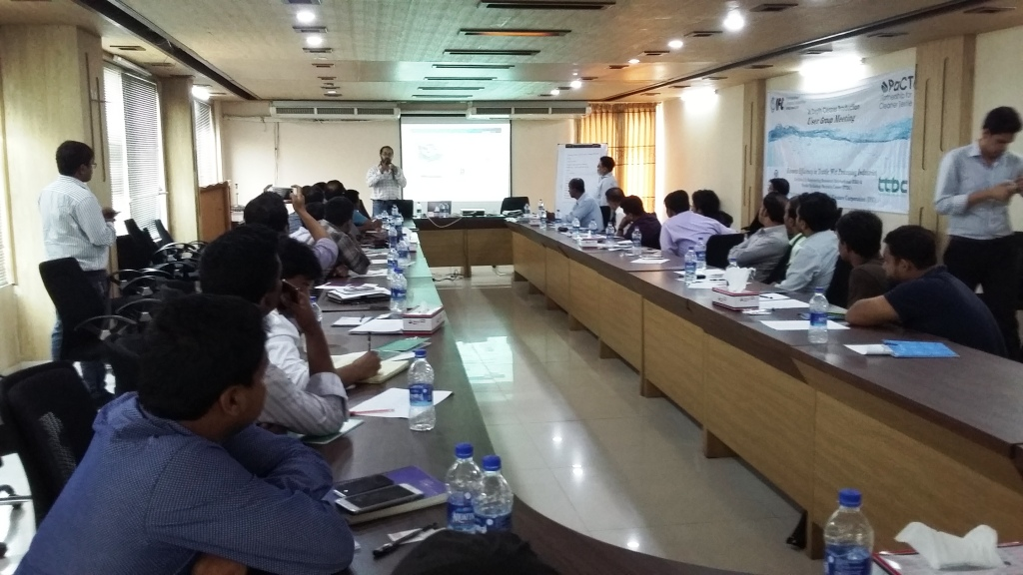

Slide 23
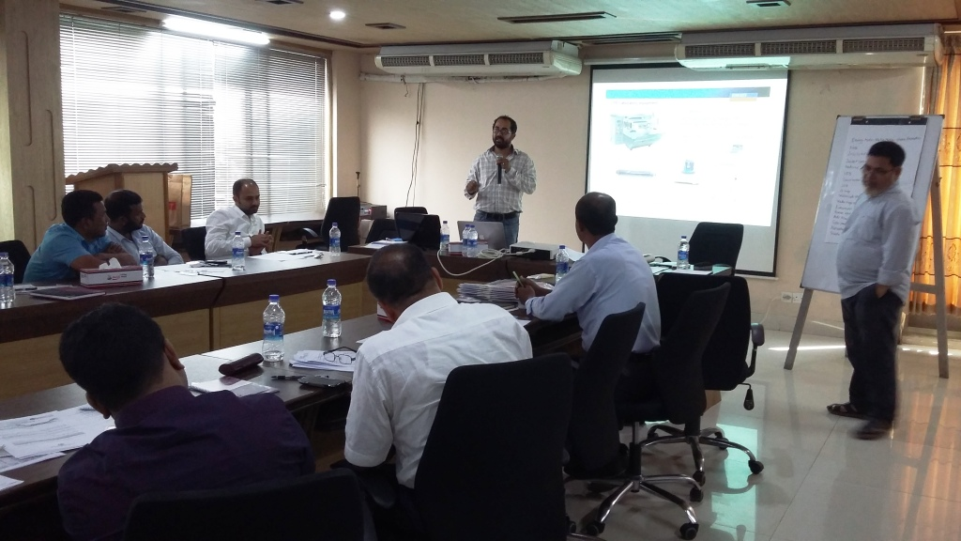

Slide 24
DTG FAIR
2019
2018
2017
2016

Slide 25
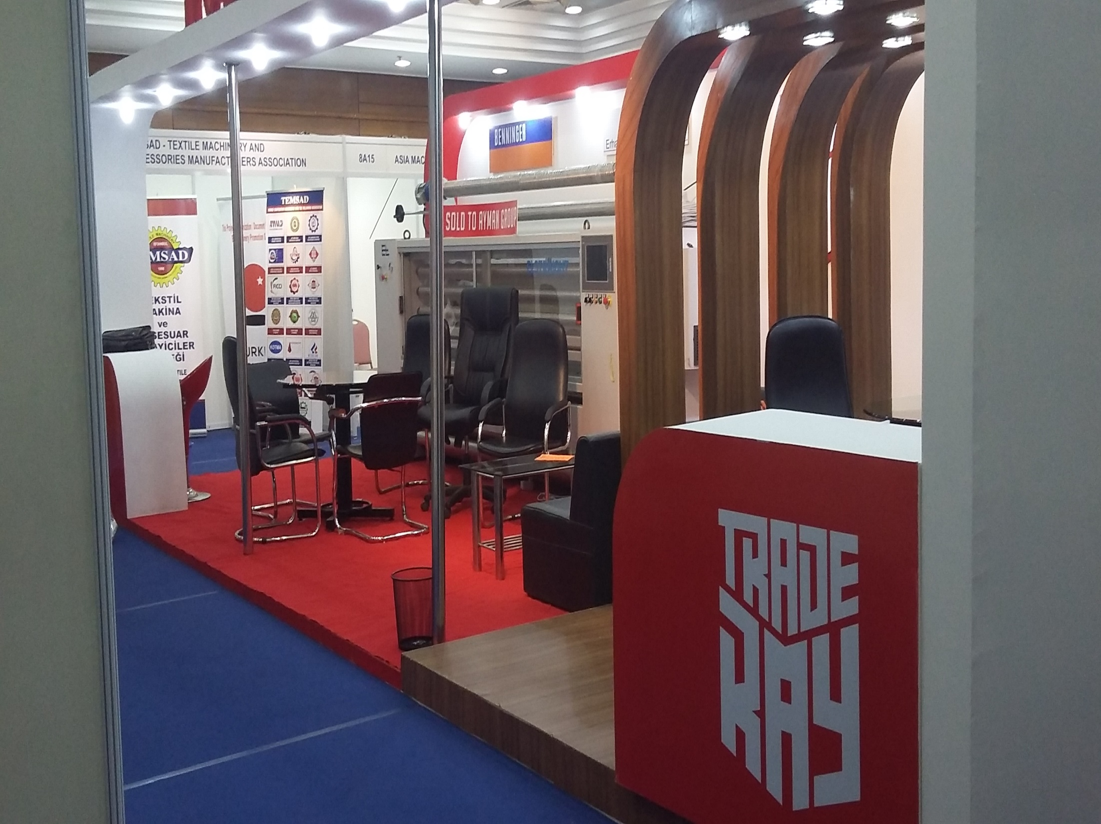

Slide 26
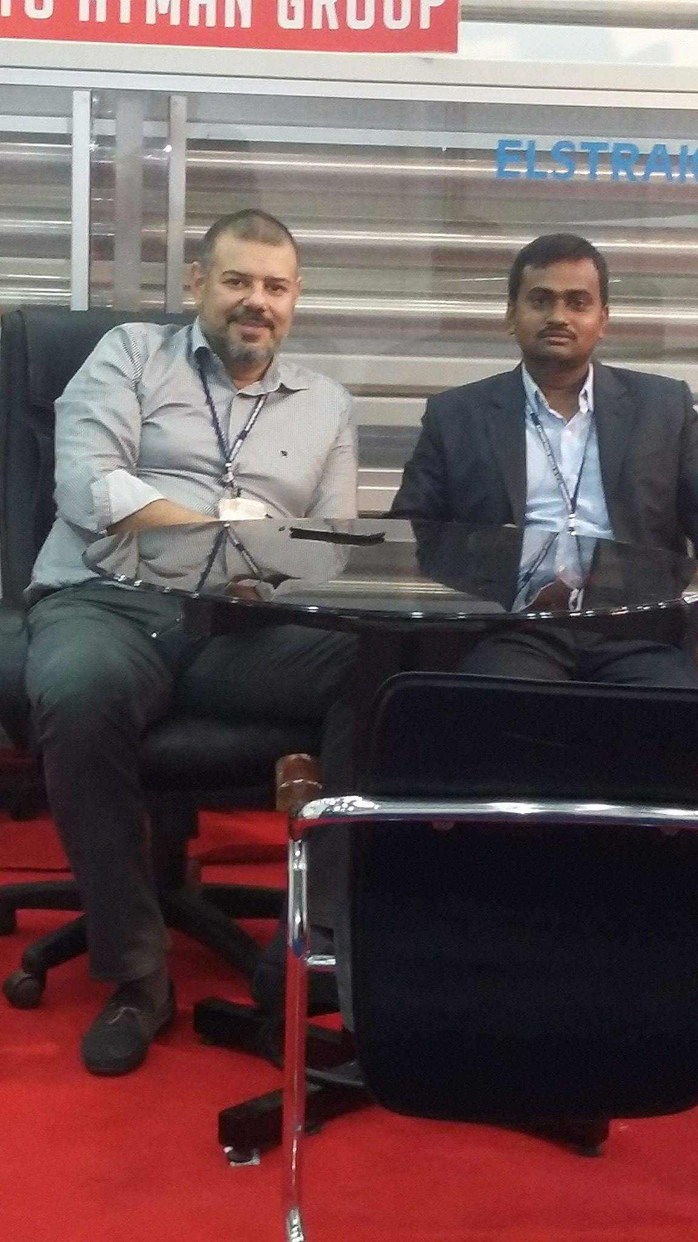
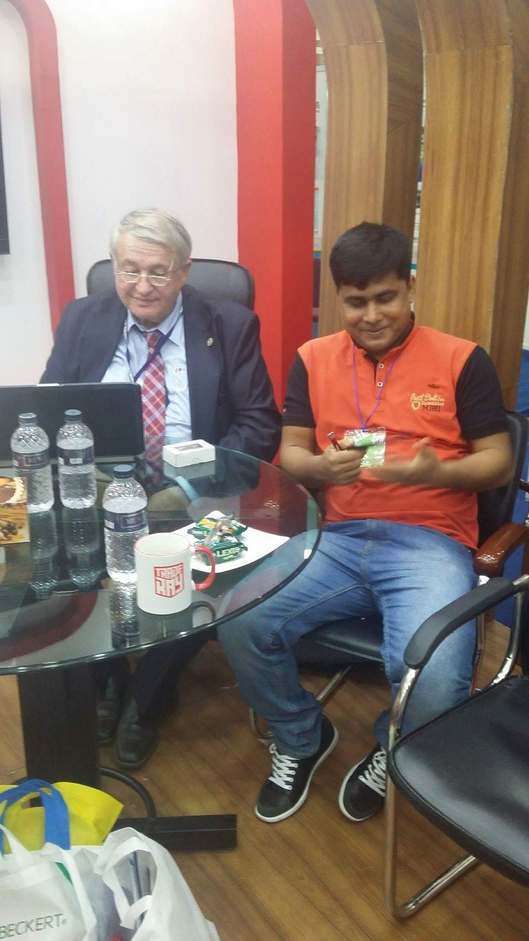

Slide 27
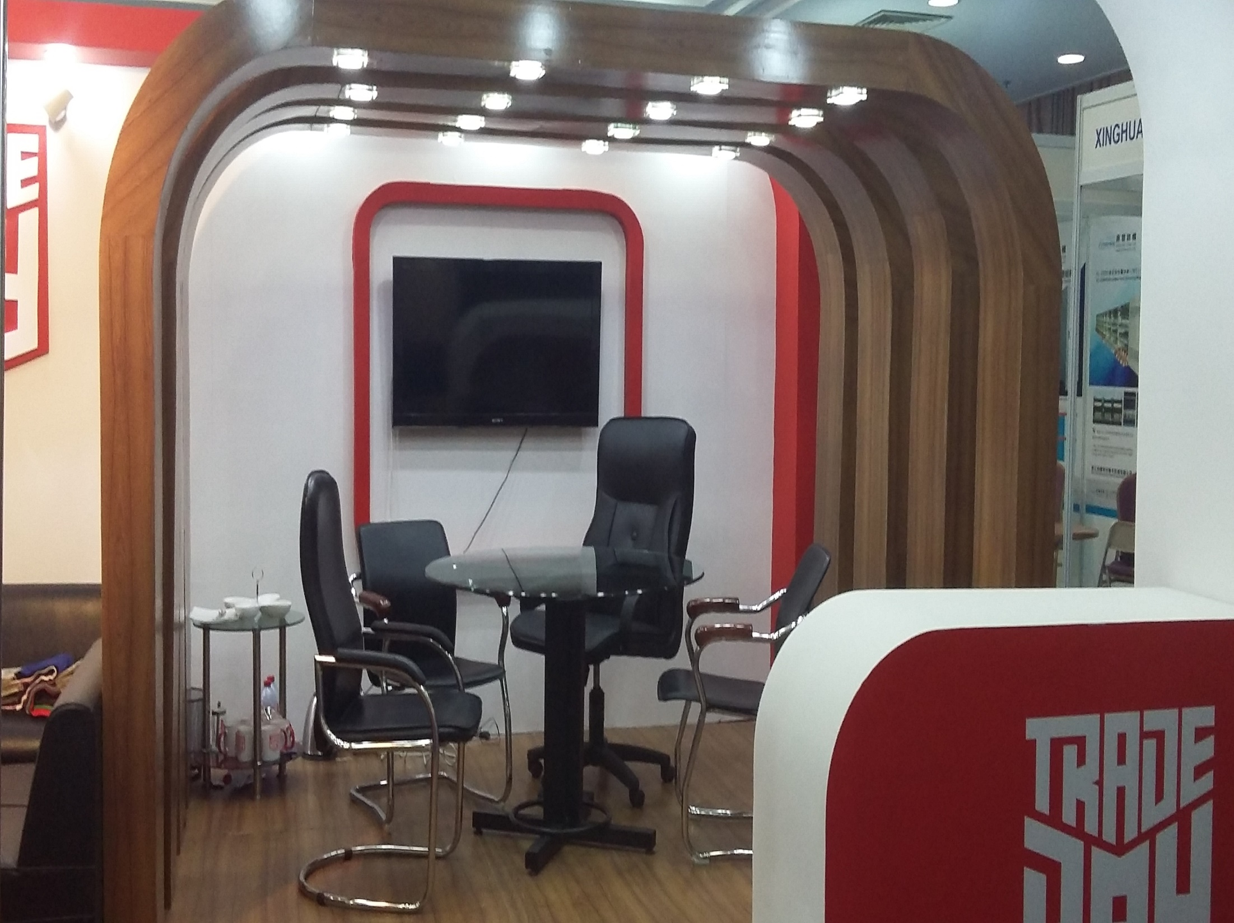

Slide 28
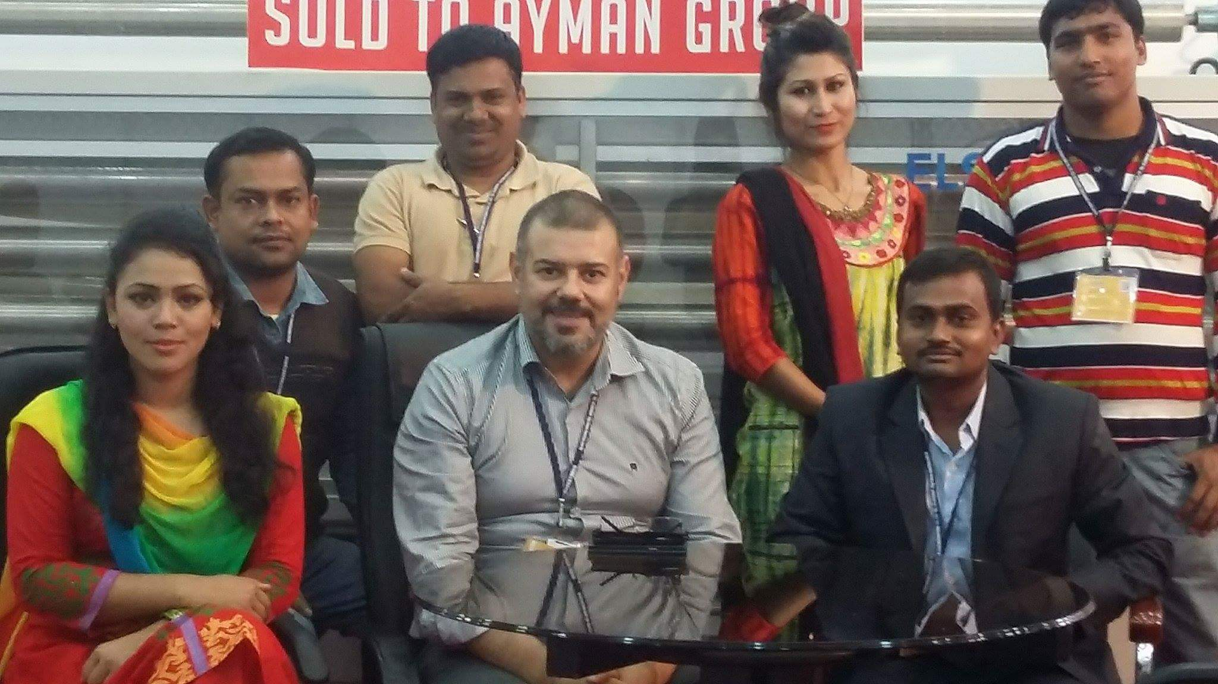

Slide 29
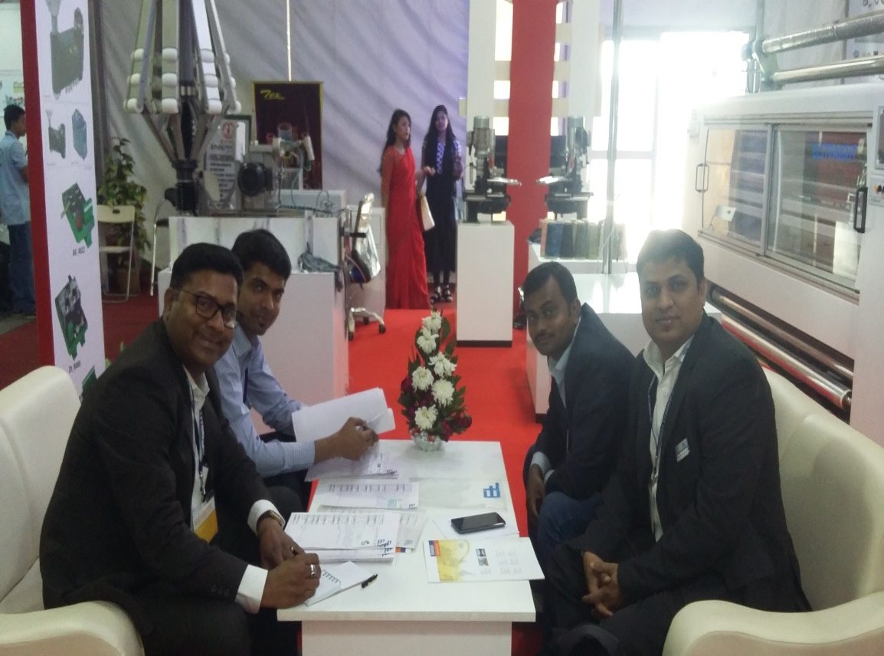
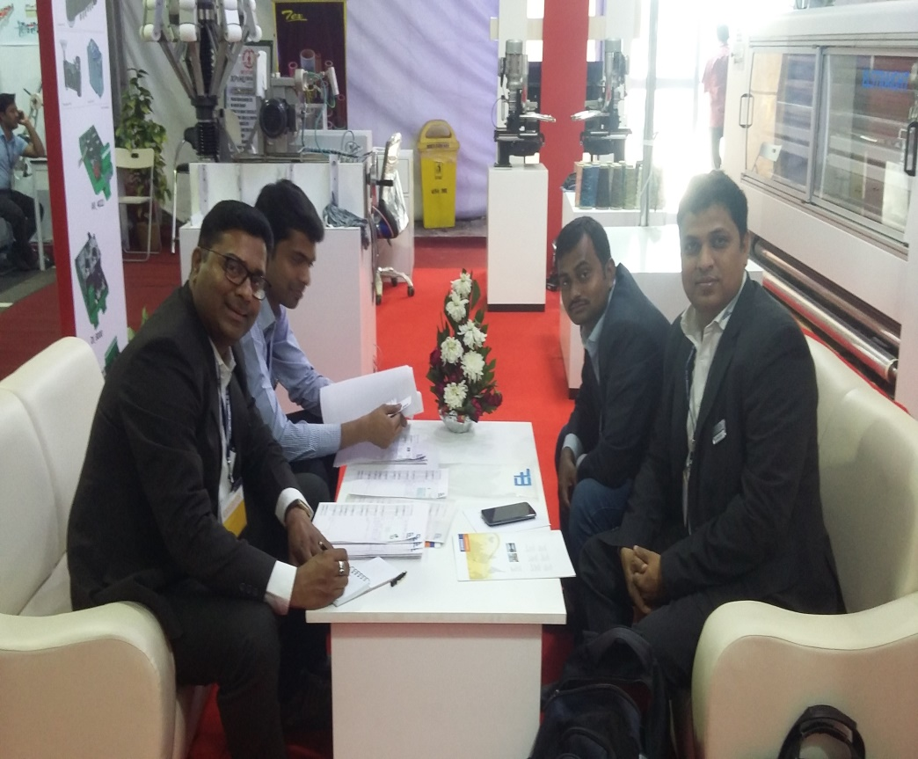
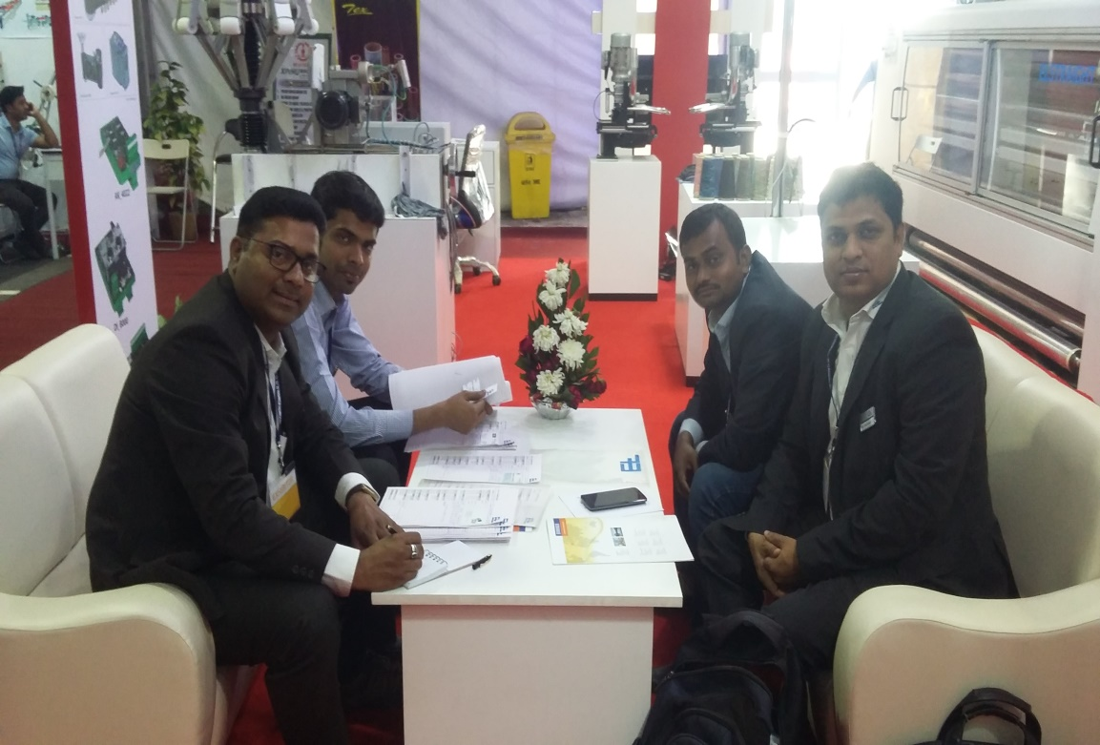
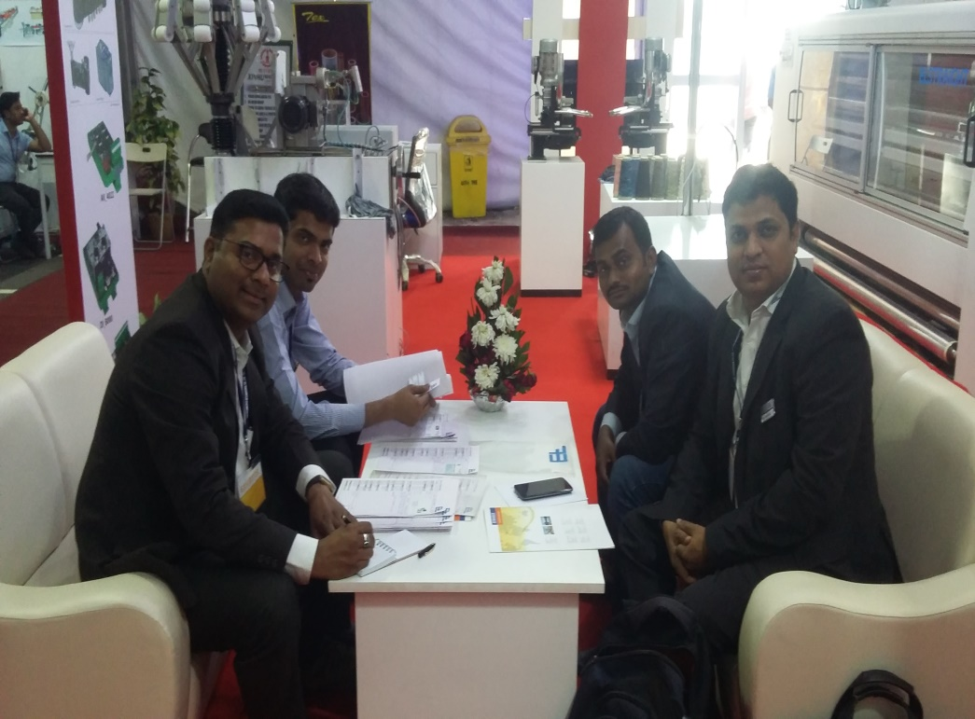

Slide 30
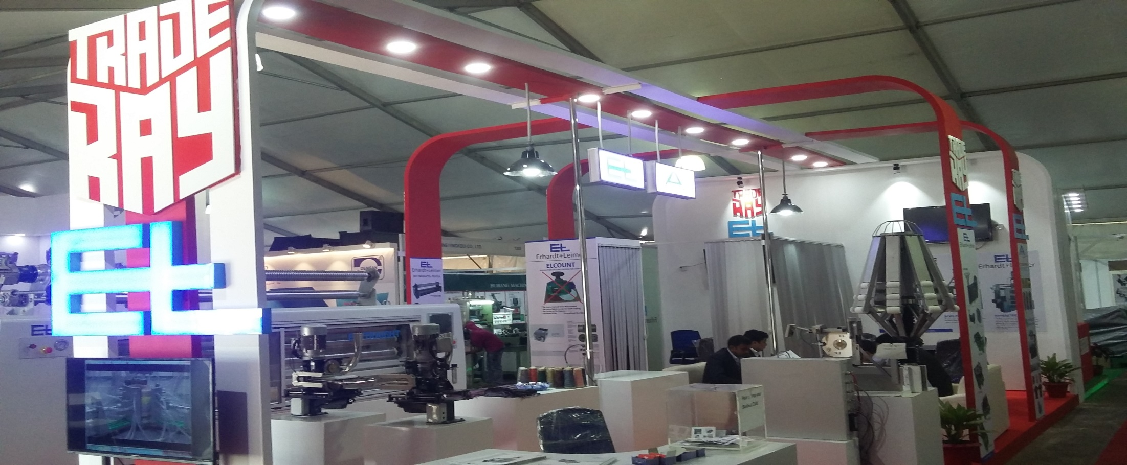
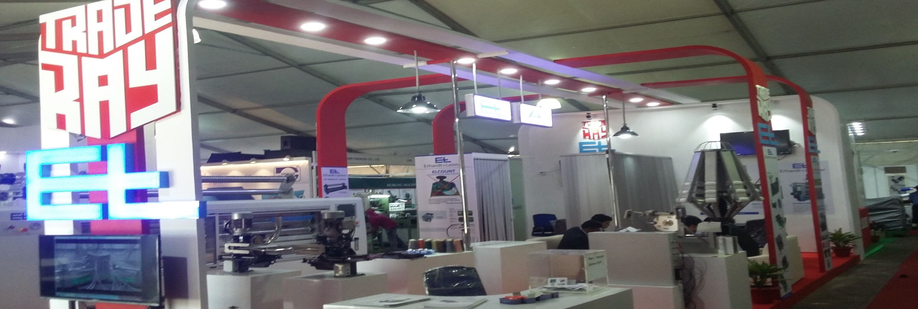

Slide 31
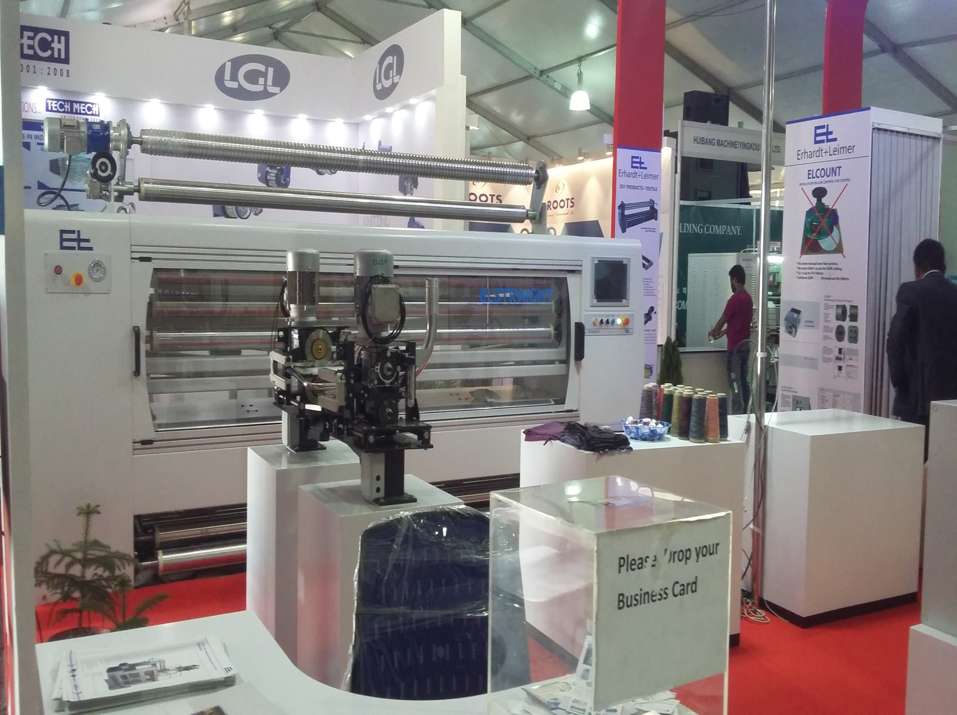

Slide 32
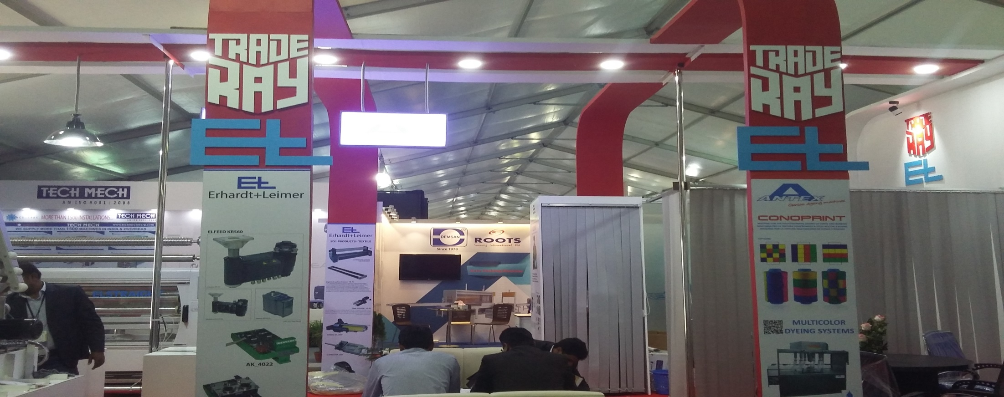
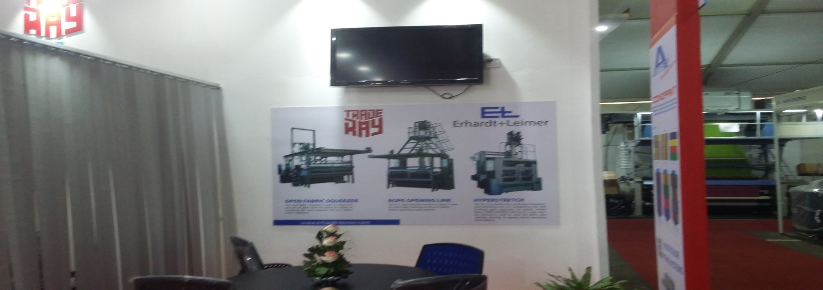

Slide 33
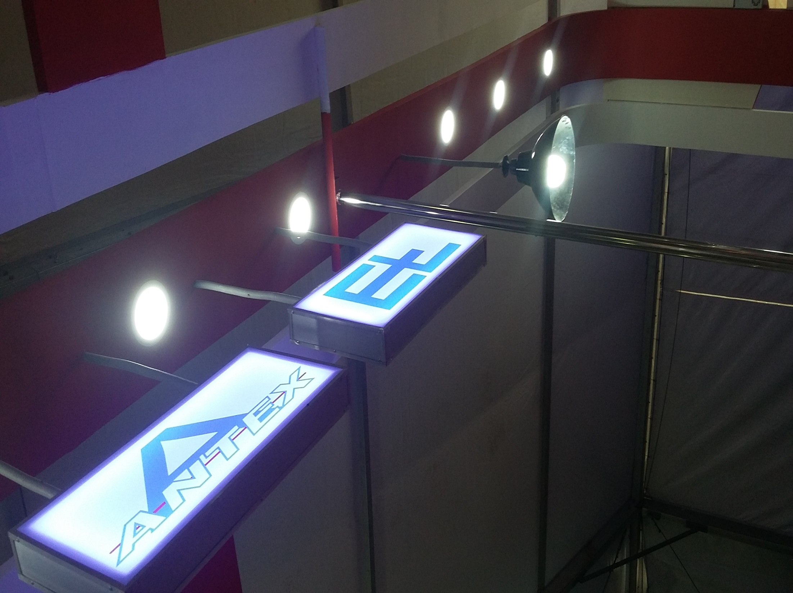

Slide 34
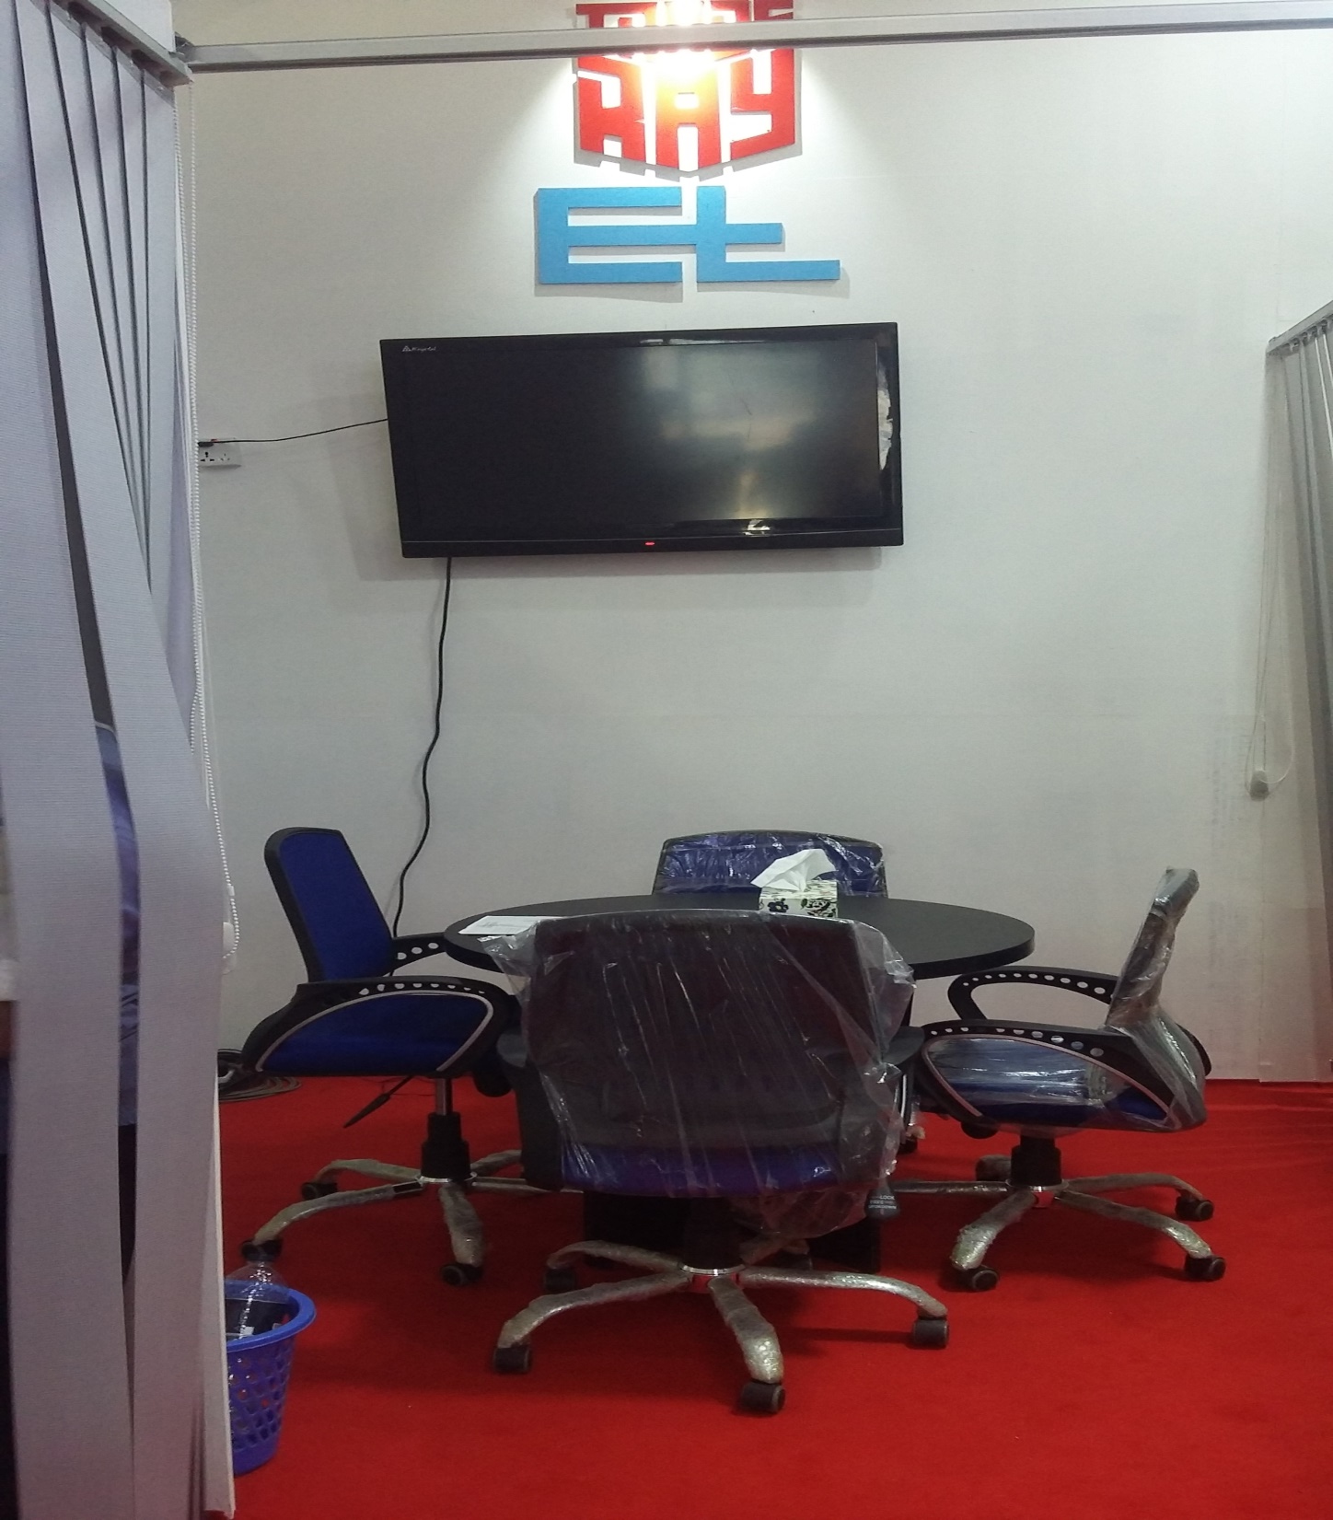

Slide 35
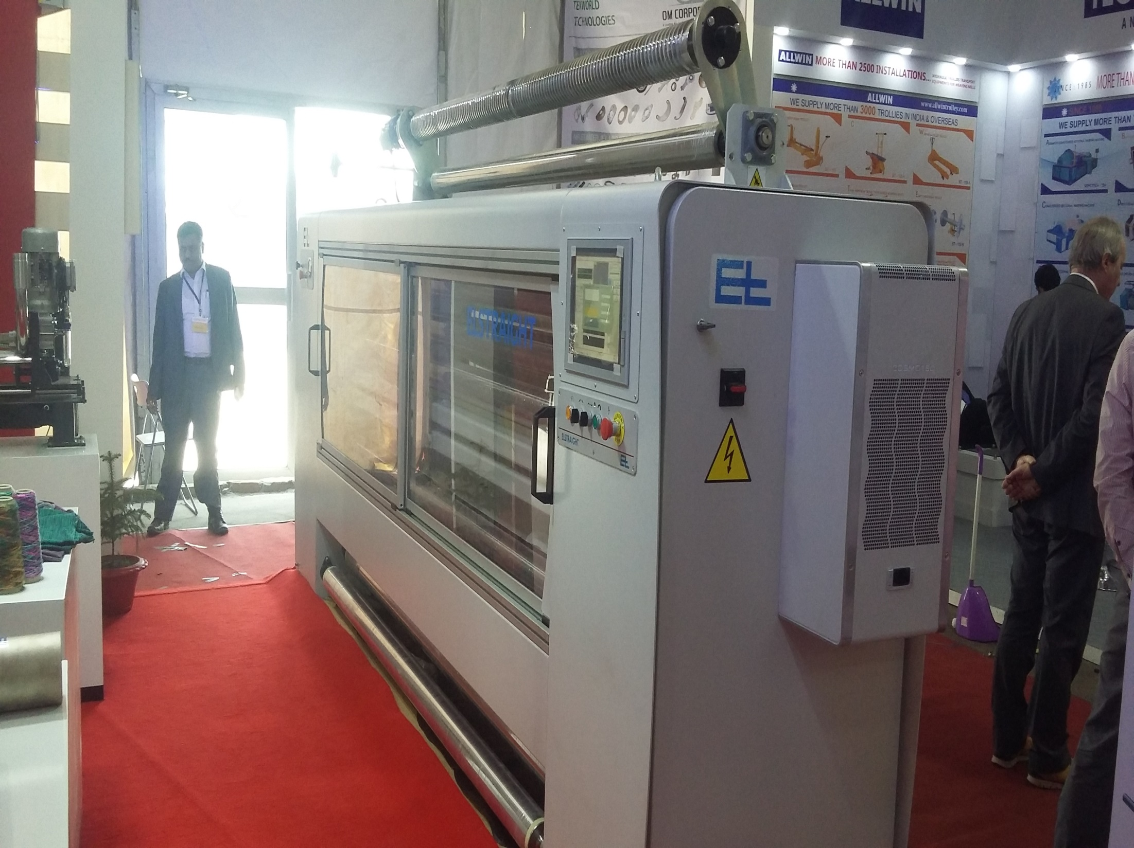

Slide 36
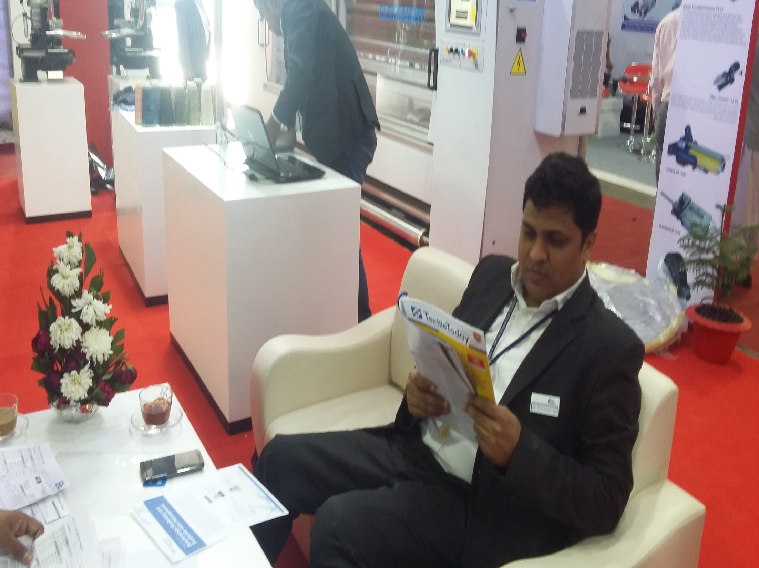

Slide 37
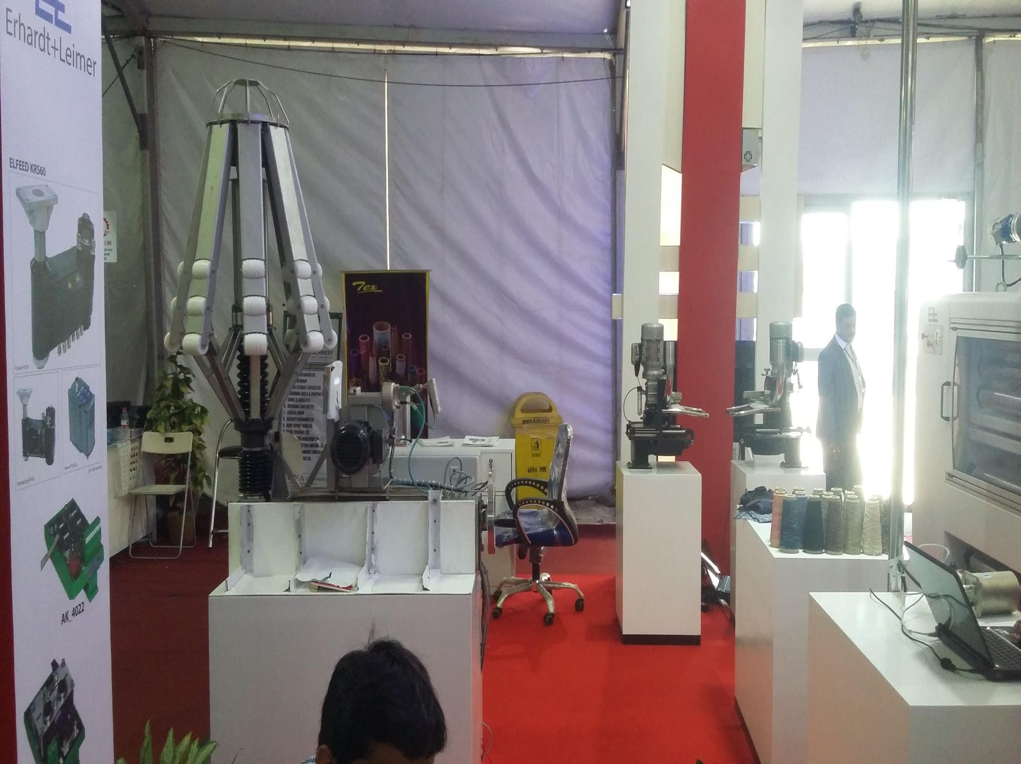

Slide 38
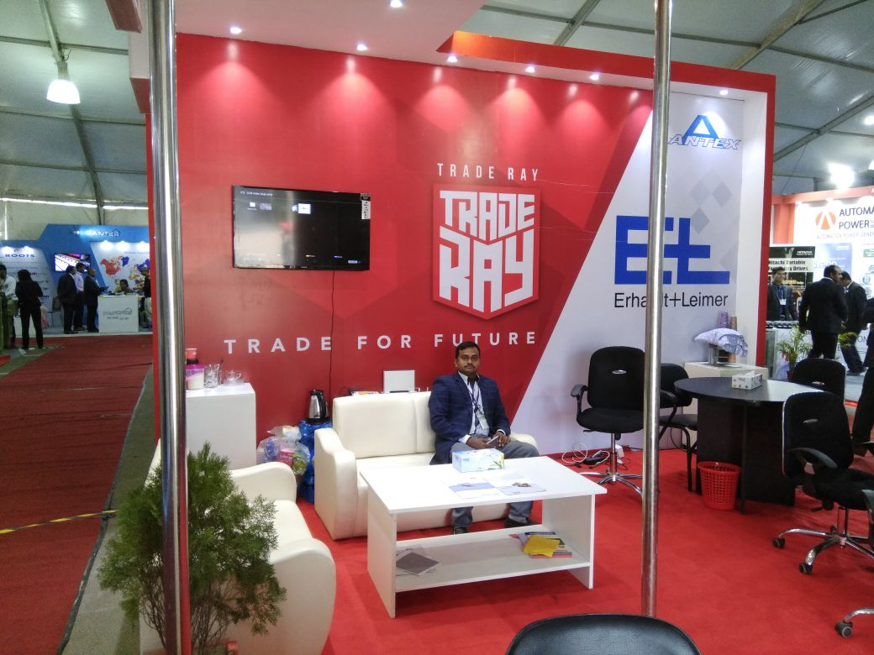

Slide 39
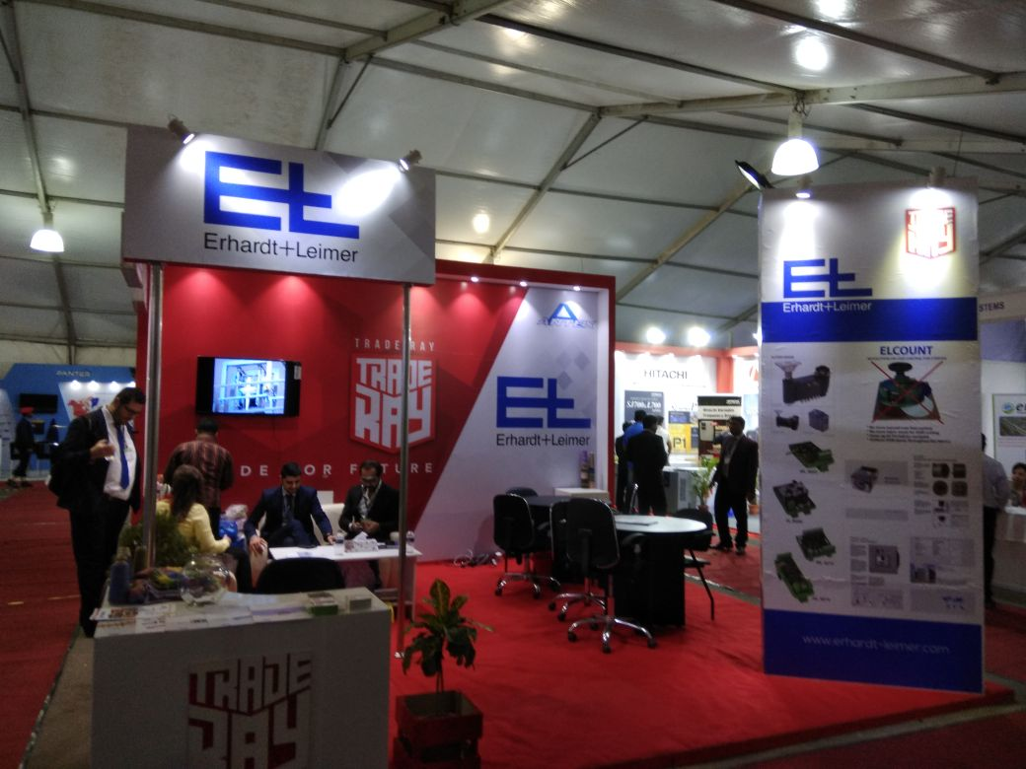

Slide 40
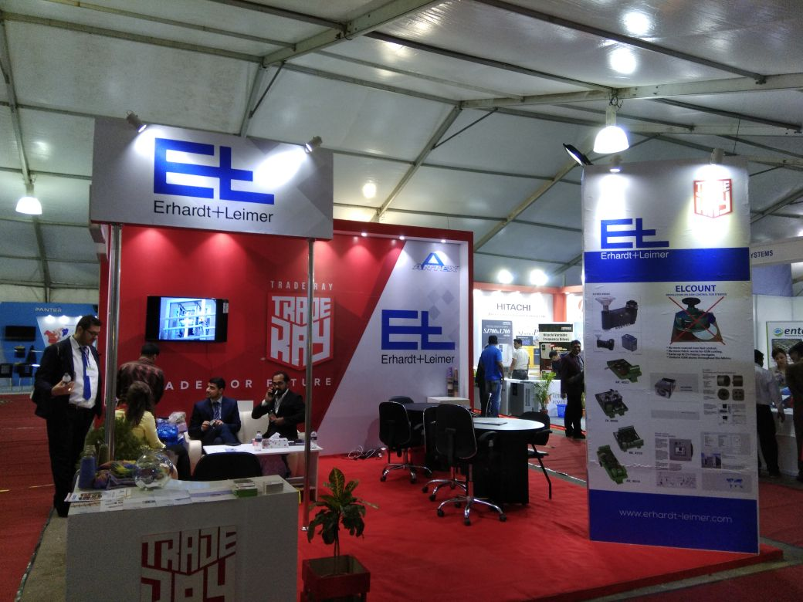

Slide 41
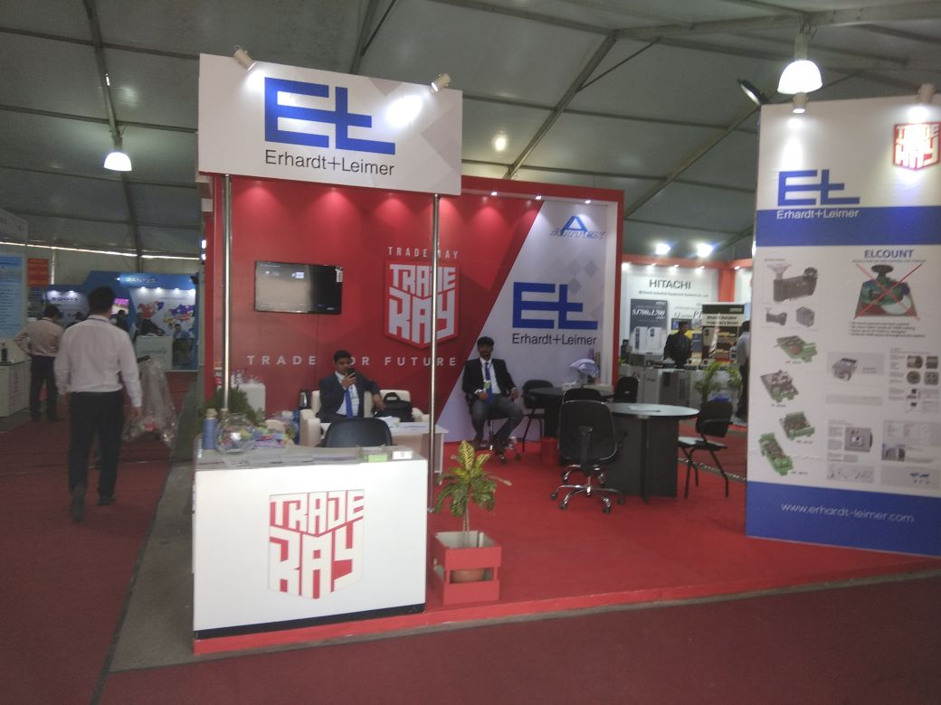

Slide 42
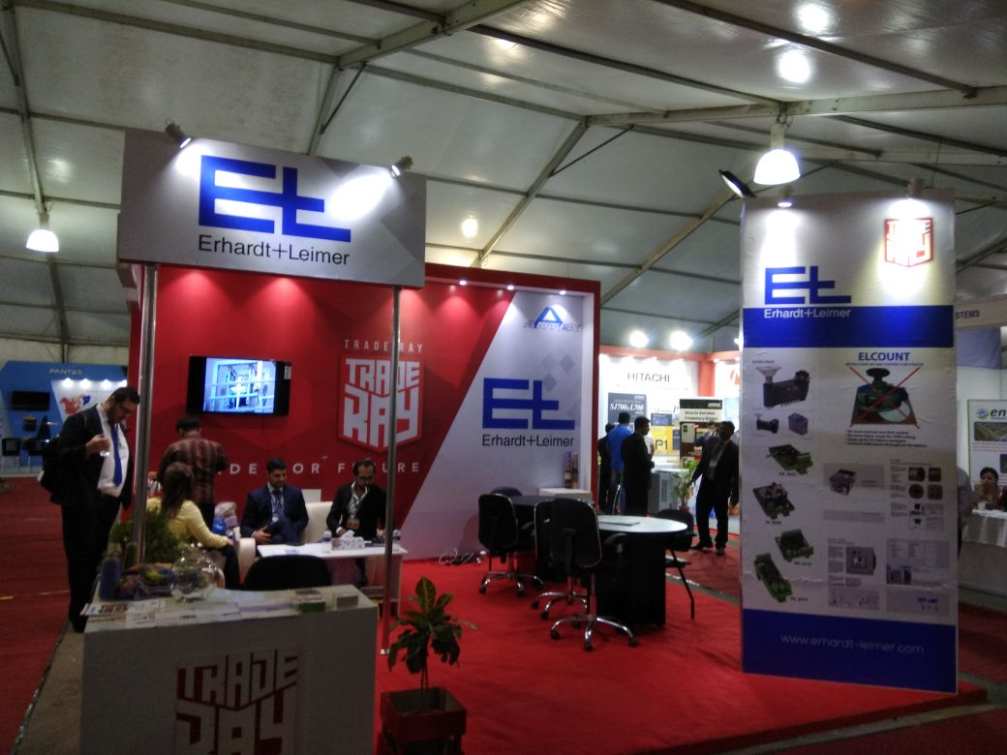

Slide 43
THANKS TO ALL

